Slide 1
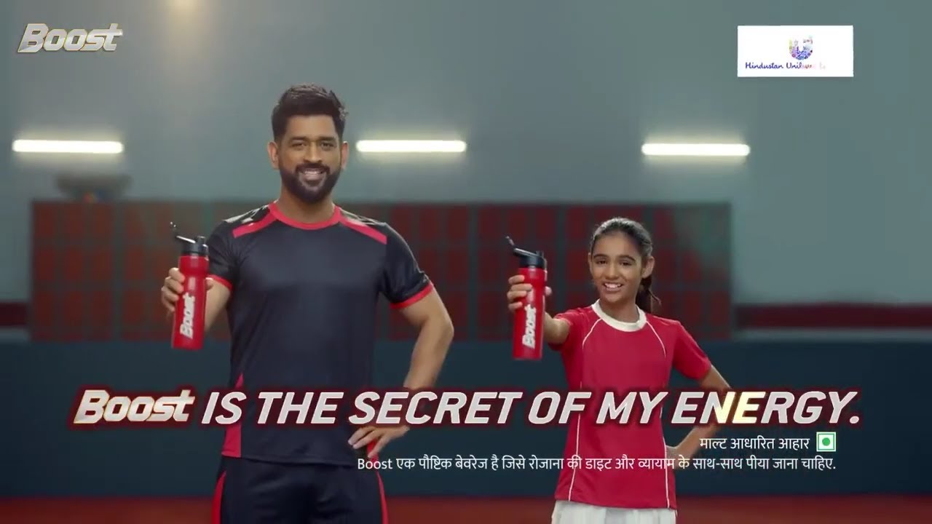
HYPOTHESIS FOR STAMINA

Slide 2
ADVERTISEMENT FROM BOOST
S.No | Particulars | No. Of respondent | Percentage
1 | Improves concentration | 6 | 12%
2 | Memory | 13 | 26%
3 | Improves physical stamina stronger | 25 | 50%
4 | If any other benefits | 6 | 12%
 | TOTAL | 50 | 100%

Slide 3
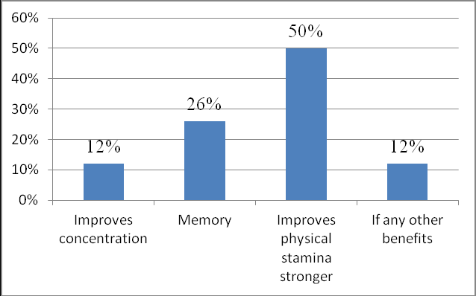
GRAPH CHART

Slide 4
S.NO | BEFORE DRINKING BOOST | AFTER DRINKING BOOST
1 | 50 | 70
2 | 43 | 73
3 | 44 | 64
4 | 69 | 80
5 | 72 | 92

Slide 5
HYPOTHESIS FOR STAMINA
Hypothesis for Stamina for before and after drinking boost is
p=0.033044
Which is less than 0.05 that is alpha.

Slide 6
CONCLUSION
IT IS TRUE THAT STAMINA OF A PERSON INCREASES AFTER DRINKING BOOST.

